Slide 1


Texas Board of Professional Engineers Professional Practice Update / Ethics
Lance Kinney, Ph.D., P.E.
Executive Director
http://engineers.texas.gov/outreachsurvey

Slide 2
Agenda
About the Board
Core Functions
  Licensing
  Enforcement
Law and Rules
Board Activities

Slide 3





Website and Social Media
http://engineers.texas.gov
Facebook: Texas Board of Professional Engineers
Twitter: TBPE_Exec
LinkedIn: Texas Board of Professional Engineers
RSS Feed on our website: http://engineers.texas.gov
YouTube: https://www.youtube.com/ channel/UCm0YTnjR3StveBxWhCT4MiA
Notes:
Our commitment is to communicate more frequently with more user-friendly information
TBPE makes announcements and posts general information and reminders through its social media links.

Slide 4
Texas Board of Professional Engineers
Nine Members - Appointed by Governor
6 Licensed Professional Engineers
3 Public Members
Standard term is 6 years

Slide 5
TBPE
Daniel O. Wong, PhD, PE Houston - Chairman
Sina K. Nejad, D.Eng, PE, PEng Beaumont - Vice Chair
Kyle Womack, PE Midland - Secretary
Edward Summers, PhD (public member) Austin - Treasurer
Lamberto “Bobby” Balli, PE San Antonio
Catherine Norwood, PE Midland
Elvira Reyna (public member) Denton County
Sockalingam “Sam” Kannappan, PE Baytown
Albert Cheng (public member) Houston

Slide 6
TBPE Staff
31 Staff members, Austin
Lance Kinney, PhD, PE - Executive Director
David Howell, PE – Deputy Executive Director
Vacant - Compliance & Enforcement
Rick Strong, PE - Licensing
Janet Sobieski - Operations

Slide 7
TBPE Mission
Public Safety
Our mission is to protect the health, safety and welfare of the people of Texas by regulating and advancing the practice of engineering through licensure of qualified individuals, compliance with the laws and rules, and education about professional engineering.

Slide 8
History of TBPE
Created by Texas Legislature (45R) in 1937
New London School Explosion
  300 students and teachers killed
  Result of improperly designed mechanical and electrical devices
Established a Board to regulate the practice of engineering through licensing and rules of practice
Notes:
Two of the engineers are college professors and the others are in private practice. Of the 3 public members, 2 are lawyers and one is a CPA.
Rules-staff produced, board approves for public comment in the Texas Register, staff takes comments and proposes new rules for Board approval

Slide 9
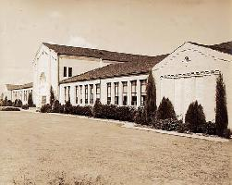
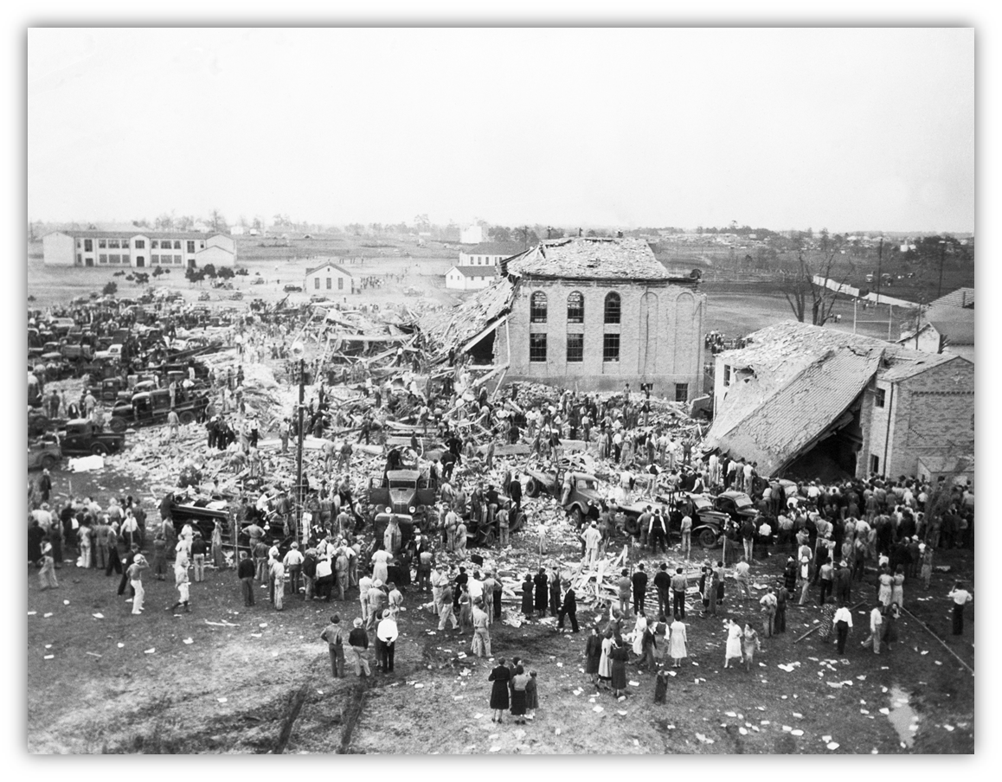
1937
Notes:
2/23/2018
9

Slide 10
Board Primary Functions
Since 1937 -
  License Qualified Engineers
  Enforce Engineering Practice Act
Since 2003 –Requiring Firm Registration
Since 2005 -Requiring Continuing Education
Now
  Educate – PEs, Officials, Potential PEs, Public

Slide 11
TBPE Licensing History
867 individuals registered on 1st roster published 02/12/1938
Over 129,000 Texas licenses granted since then.
Currently over 64,000 licenses

Slide 12
Professional Licensing
Protection of the Public
Ethical Expectations
Competence
  Initial Qualifications
    Education, Experience, Examinations
  Staying Current
    Continuing Education
Professionalism
Notes:
Professionals include doctors, lawyers, engineers, etc. There is an understanding that professionals are regulated to ensure ethical behavior which creates a safer environment

Slide 13
Professional Licensing
Fields that are regulated and licensed vary among individual states. Among regulated fields are health care professionals (medical doctors, nurses); psychologists; lawyers; teachers; engineers; …- Wikipedia
Most of these fields impact the public one person at a time.
The work done by engineers generally has the potential to affect many.
Notes:
Professionals include doctors, lawyers, engineers, etc. There is an understanding that professionals are regulated to ensure ethical behavior which creates a safer environment

Slide 14
Professional Licensing
System to Protect the Public:
Sets the minimum standards for licensure as a Professional Engineer
Sets continuing practice and competence standards
Sets ethical and professional standards
Compliance with these standards of professional practice
Standards for indicating competence (titles, seals, etc.)
Prevents unqualified individuals from offering or practicing where it could endanger the public
Notes:
Professionals include doctors, lawyers, engineers, etc. There is an understanding that professionals are regulated to ensure ethical behavior which creates a safer environment

Slide 15
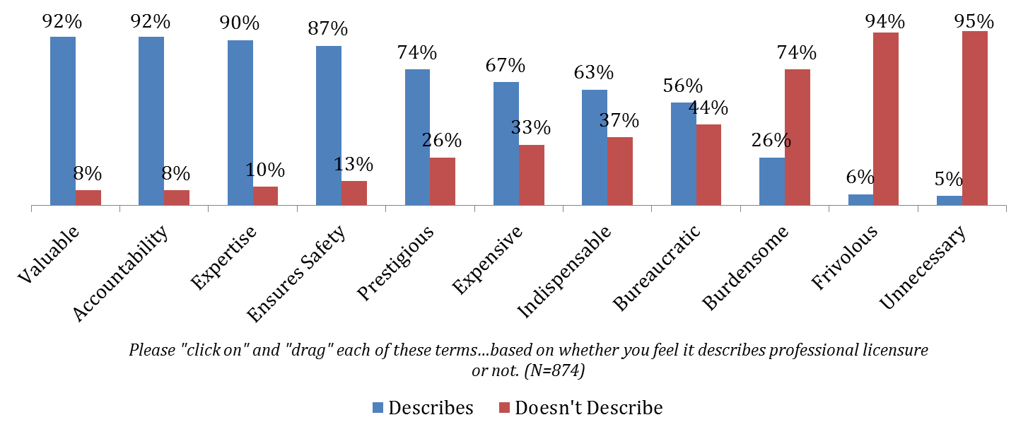
Public Perception - Licensure
Survey by McKinley Advisors
Notes:
Professionals include doctors, lawyers, engineers, etc. There is an understanding that professionals are regulated to ensure ethical behavior which creates a safer environment

Slide 16
Public Perception - Licensure
Survey by McKinley Advisors
Notes:
Professionals include doctors, lawyers, engineers, etc. There is an understanding that professionals are regulated to ensure ethical behavior which creates a safer environment

Slide 17
Licensing
Competence
Competence is gained by Education and Experience; Measured by FE and PE examinations
Texas uses nationally accepted standards, but considers each application independently.
Texas does not license by discipline, but Professional Engineers must not practice outside of their competence.
  §137.59(a) Engineers shall practice only in their areas of competence.
Notes:
Professionals include doctors, lawyers, engineers, etc. There is an understanding that professionals are regulated to ensure ethical behavior which creates a safer environment

Slide 18

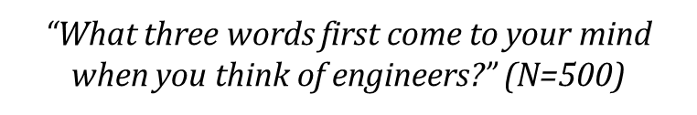
Public Perception of Engineers
Survey by McKinley Advisors
Notes:
Professionals include doctors, lawyers, engineers, etc. There is an understanding that professionals are regulated to ensure ethical behavior which creates a safer environment

Slide 19
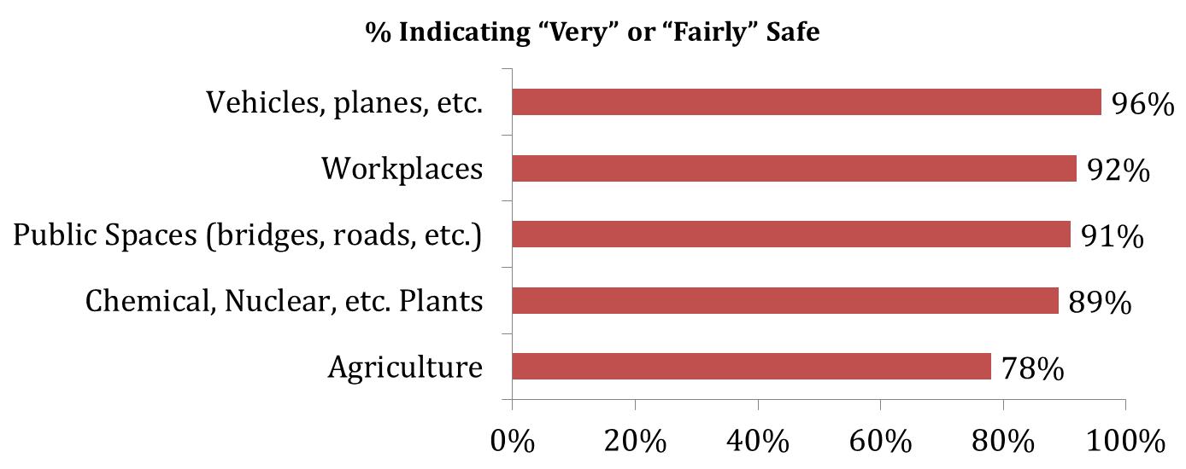
Public Perception - Safety
Survey by McKinley Advisors
Notes:
Professionals include doctors, lawyers, engineers, etc. There is an understanding that professionals are regulated to ensure ethical behavior which creates a safer environment

Slide 20

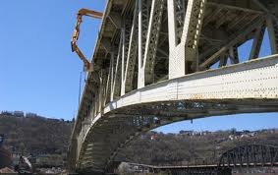
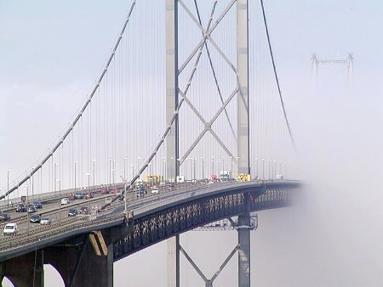
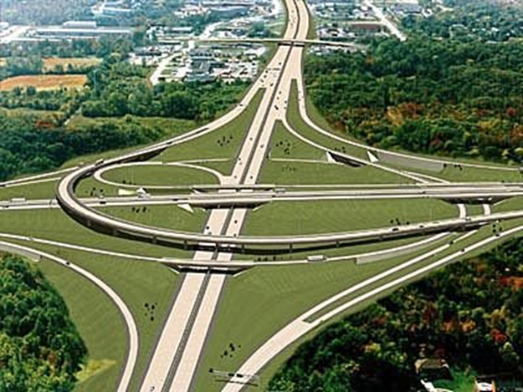
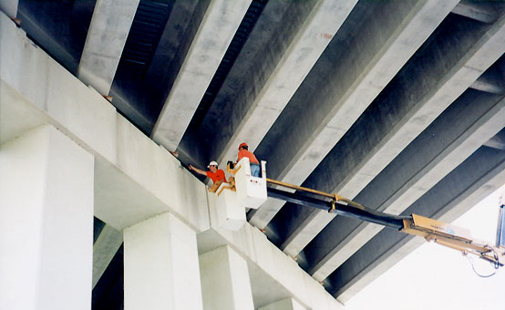

Slide 21
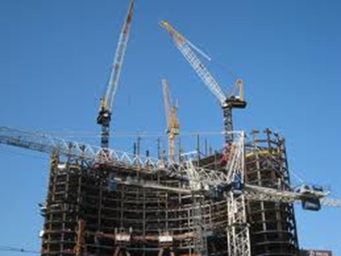
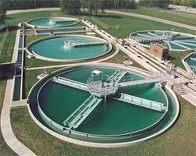
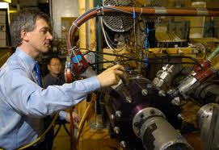
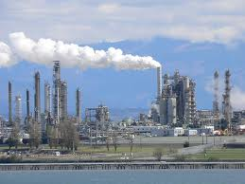
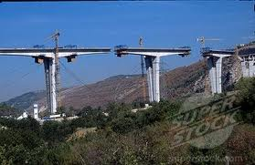

Slide 22
Engineering Ethics
Protection of Public Health, Safety, Welfare
Ethical responsibilities and expectations
  Avoid Conflicts of Interest
  Be a Faithful Agent
  Be prepared to have a dissenting opinion, if necessary
  Obligation to be aware of violations of the Act.
How does this protect the public?
  We are expected to know the right thing to do and to do the right thing in the practice of engineering.
Notes:
Professionals include doctors, lawyers, engineers, etc. There is an understanding that professionals are regulated to ensure ethical behavior which creates a safer environment

Slide 23
Licensing
Ethics / Professionalism
Multiple reference statements from other licensed engineers to vouch for character and engineering experience claimed.
Exam on Texas Law and Rules
Fingerprint-based CHRC
Continuing Education related to Ethics after licensure
Notes:
Professionals include doctors, lawyers, engineers, etc. There is an understanding that professionals are regulated to ensure ethical behavior which creates a safer environment

Slide 24
Professionalism
Protection of Public Health, Safety, Welfare
Communication
  Honesty
  Clarity (not misleading)
  Respectful of all parties
  Maintain Public Trust
  Timely communication with the TBPE
How does this protect the public?
  We are expected to be complete and correct in the practice of engineering.
Notes:
Professionals include doctors, lawyers, engineers, etc. There is an understanding that professionals are regulated to ensure ethical behavior which creates a safer environment

Slide 25
Professional Licensing
Public Perception of Engineers:
Please tell me how you would rate the honesty and ethical standards of people in these different fields -- very high, high, average, low or very low? (Gallup 2016)
Profession | % Very High / High
Nurses | 84%
Military Officers | 71%
Pharmacists | 67%
Engineers | 65%
Medical Doctors | 65%
Police Officers | 58%
Notes:
Professionals include doctors, lawyers, engineers, etc. There is an understanding that professionals are regulated to ensure ethical behavior which creates a safer environment

Slide 26
Compliance & Enforcement
Technical / Ethical / Professional
  Approximately 600 Cases opened last year
  64,970 licensed PEs (01/2018)
  About 65% resolved with Voluntary Compliance
  Board action includes range of action up to revocation
  Less than 10% Dismissed

Slide 27
Enforcement - Filing A Complaint
Mail, email, phone, facsimile – all are acceptable for initial contact
  Anonymous complaints are accepted
A complaint form or detailed letter/email is needed to cover all the bases
  Forms can be found Online
Provide specific instances of violation
Provide evidence to show probable cause
Notes:
Ou
27

Slide 28
Board Actions
Reprimands (Formal and Informal)
Suspension (possible probation)
Refuse to Renew
Revocation
$5,000 per violation per day
Cease and Desist Orders
Emergency Suspension
Notes:
Be aware of consequences.
Make sure you know the rules and statutes and please call us if you have any questions at all. We want to prevent the cases by providing you answers before the violations occur!
28

Slide 29
Additional Enforcement Options
Ethics Courses
  National Institute for Engineering Ethics (Texas Tech)
Technical Courses
Restitution
Practice limitations
Civil or Criminal cases
  Assisting Jurisdictional Authorities
Notes:
Be aware of consequences.
Make sure you know the rules and statutes and please call us if you have any questions at all. We want to prevent the cases by providing you answers before the violations occur!
29

Slide 30
Enforcement
By law, all violations, except informal reprimands, must be published
  On TBPE website by Board Meeting Date
  Added to NCEES Enforcement Exchange (national database)
  Published in the newsletter which is mailed at least annually and quarterly E-newsletter emails
Notes:
30

Slide 31
Preventing Complaints
CLEAR:
  Communication (between all parties)
  Contract (expectations and responsibilities)
  Calculations and designs (be prepared to support)
Keep your Documentation
Most importantly – know the law, and contact us if you have a question!
Notes:
2/23/2018
31
We don’t want to hear about you – and here’s how!
Communication – usually a simple misunderstanding can be cleared up easily – manage expectations in advance
Contracts – get it in writing so everyone understands
Calculations – show your work and keep the notes. It will help if there is ever a question about what was done.

Slide 32
Educate
PEs, Officials, Potential PEs, Public
What is a P.E.? / What do they do?
Public Perception
The Value of Licensure
How does the TBPE fit in?

Slide 33
Educate
Engagement
Outreach
  Presentations, webinars, publications
Advisory Groups
  Working with customer groups directly
  Government, Academia, Industry, Future Engineers

Slide 34
Engagement –
Professional and Technical Organizations
Rule 137.63(a) – [Engineers] should attempt to enhance society’s awareness of engineers’ responsibilities to the public and encourage the communication of these principles of ethical conduct among engineers.
Training and Continuing Education
Engineering Policy
Latest Technical Information
Engineering Networking / Mentoring / References
Notes:
Professionals include doctors, lawyers, engineers, etc. There is an understanding that professionals are regulated to ensure ethical behavior which creates a safer environment

Slide 35





Outreach Publications
Notes:
Professionals include doctors, lawyers, engineers, etc. There is an understanding that professionals are regulated to ensure ethical behavior which creates a safer environment

Slide 36
Professional Services Procurement Act (PSPA)
Qualifications Based Selection (QBS) for engineering on public projects
Responsibilities of Professional Engineers
Responsibilities of Public Officials in RFQ / RFP process
Notes:
Professionals include doctors, lawyers, engineers, etc. There is an understanding that professionals are regulated to ensure ethical behavior which creates a safer environment

Slide 37
Continuing Education
  15 hours
    Must include 1 hour of Ethics
    May include up to 5 hours of self-study
    May include up to 3 hours of Educational Outreach
  Random audits ongoing
  Keep documentation for 3 years
  Fines as high as $5,000; separate violations for claiming Continuing Ed without documentation or not responding to Board.
Notes:
2/23/2018
37
Know the CE requirements because this is usually have a few questions. Up to five hours of self-study
14 hours can be carried forward, one hour must be in ethics every year,
An hour should be considered the amount of time on topic; topics are not pre-approved so it’s the honor system that what you have taken is relevant to your professional practice per statute 1001.210. 137.17
There is not an exemption for over 65 – which is the #1 reason we return renewal checks
If you renew and haven’t done the CE it is fraudulent. Otherwise good engineers can be busted.
There is no pre-certification; PEs are expected to know what classes are accepted.
All done electronically.
Ask them their experience – how many of you have been audited? Was it pretty easy? Just needed to have documentation, right?

Slide 38
Continuing Education
  Exemptions - must be claimed when you renew
  1st renewal after passing the PE exam for licensure
  Active duty military deployment
  Disability
  Inactive status
  Being over 65 is not an exemption for Continuing Ed
Notes:
2/23/2018
38
Know the CE requirements because this is usually have a few questions. Up to five hours of self-study
14 hours can be carried forward, one hour must be in ethics every year,
An hour should be considered the amount of time on topic; topics are not pre-approved so it’s the honor system that what you have taken is relevant to your professional practice per statute 1001.210. 137.17
There is not an exemption for over 65 – which is the #1 reason we return renewal checks
If you renew and haven’t done the CE it is fraudulent. Otherwise good engineers can be busted.
There is no pre-certification; PEs are expected to know what classes are accepted.
All done electronically.
Ask them their experience – how many of you have been audited? Was it pretty easy? Just needed to have documentation, right?

Slide 39
Continuing Education
  New NCEES system for Continuing Professional Competence (CPC) tracking and reporting
    No fee to register and create an account
    Upload documentation
    Report as needed for different Boards
  http://ncees.org/cpc/
Notes:
2/23/2018
39
Know the CE requirements because this is usually have a few questions. Up to five hours of self-study
14 hours can be carried forward, one hour must be in ethics every year,
An hour should be considered the amount of time on topic; topics are not pre-approved so it’s the honor system that what you have taken is relevant to your professional practice per statute 1001.210. 137.17
There is not an exemption for over 65 – which is the #1 reason we return renewal checks
If you renew and haven’t done the CE it is fraudulent. Otherwise good engineers can be busted.
There is no pre-certification; PEs are expected to know what classes are accepted.
All done electronically.
Ask them their experience – how many of you have been audited? Was it pretty easy? Just needed to have documentation, right?

Slide 40
NCEES CPC
  Storage
  User specified reporting
    By date
    By State
  Accepted for Continuing Education Audit Purposes.
Notes:
2/23/2018
40
Know the CE requirements because this is usually have a few questions. Up to five hours of self-study
14 hours can be carried forward, one hour must be in ethics every year,
An hour should be considered the amount of time on topic; topics are not pre-approved so it’s the honor system that what you have taken is relevant to your professional practice per statute 1001.210. 137.17
There is not an exemption for over 65 – which is the #1 reason we return renewal checks
If you renew and haven’t done the CE it is fraudulent. Otherwise good engineers can be busted.
There is no pre-certification; PEs are expected to know what classes are accepted.
All done electronically.
Ask them their experience – how many of you have been audited? Was it pretty easy? Just needed to have documentation, right?

Slide 41
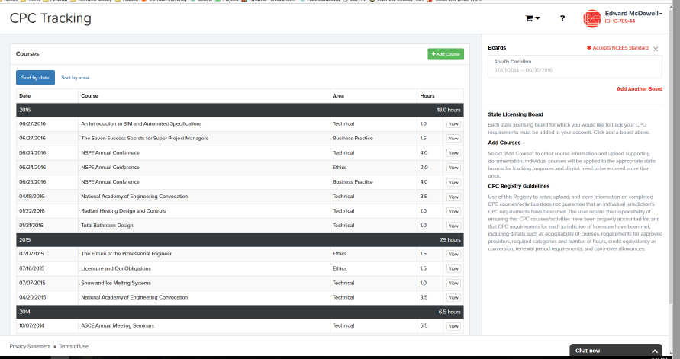
NCEES CPC
Notes:
2/23/2018
41
Know the CE requirements because this is usually have a few questions. Up to five hours of self-study
14 hours can be carried forward, one hour must be in ethics every year,
An hour should be considered the amount of time on topic; topics are not pre-approved so it’s the honor system that what you have taken is relevant to your professional practice per statute 1001.210. 137.17
There is not an exemption for over 65 – which is the #1 reason we return renewal checks
If you renew and haven’t done the CE it is fraudulent. Otherwise good engineers can be busted.
There is no pre-certification; PEs are expected to know what classes are accepted.
All done electronically.
Ask them their experience – how many of you have been audited? Was it pretty easy? Just needed to have documentation, right?

Slide 42
Licensing
Did you know???
Only about 20% of US engineers are licensed.
Bureau of Labor Statistics (2016)
146,400 engineers in Texas
  Civil – 26,500
  Petroleum - 18,000
  Industrial – 16,000
Notes:
Professionals include doctors, lawyers, engineers, etc. There is an understanding that professionals are regulated to ensure ethical behavior which creates a safer environment

Slide 43
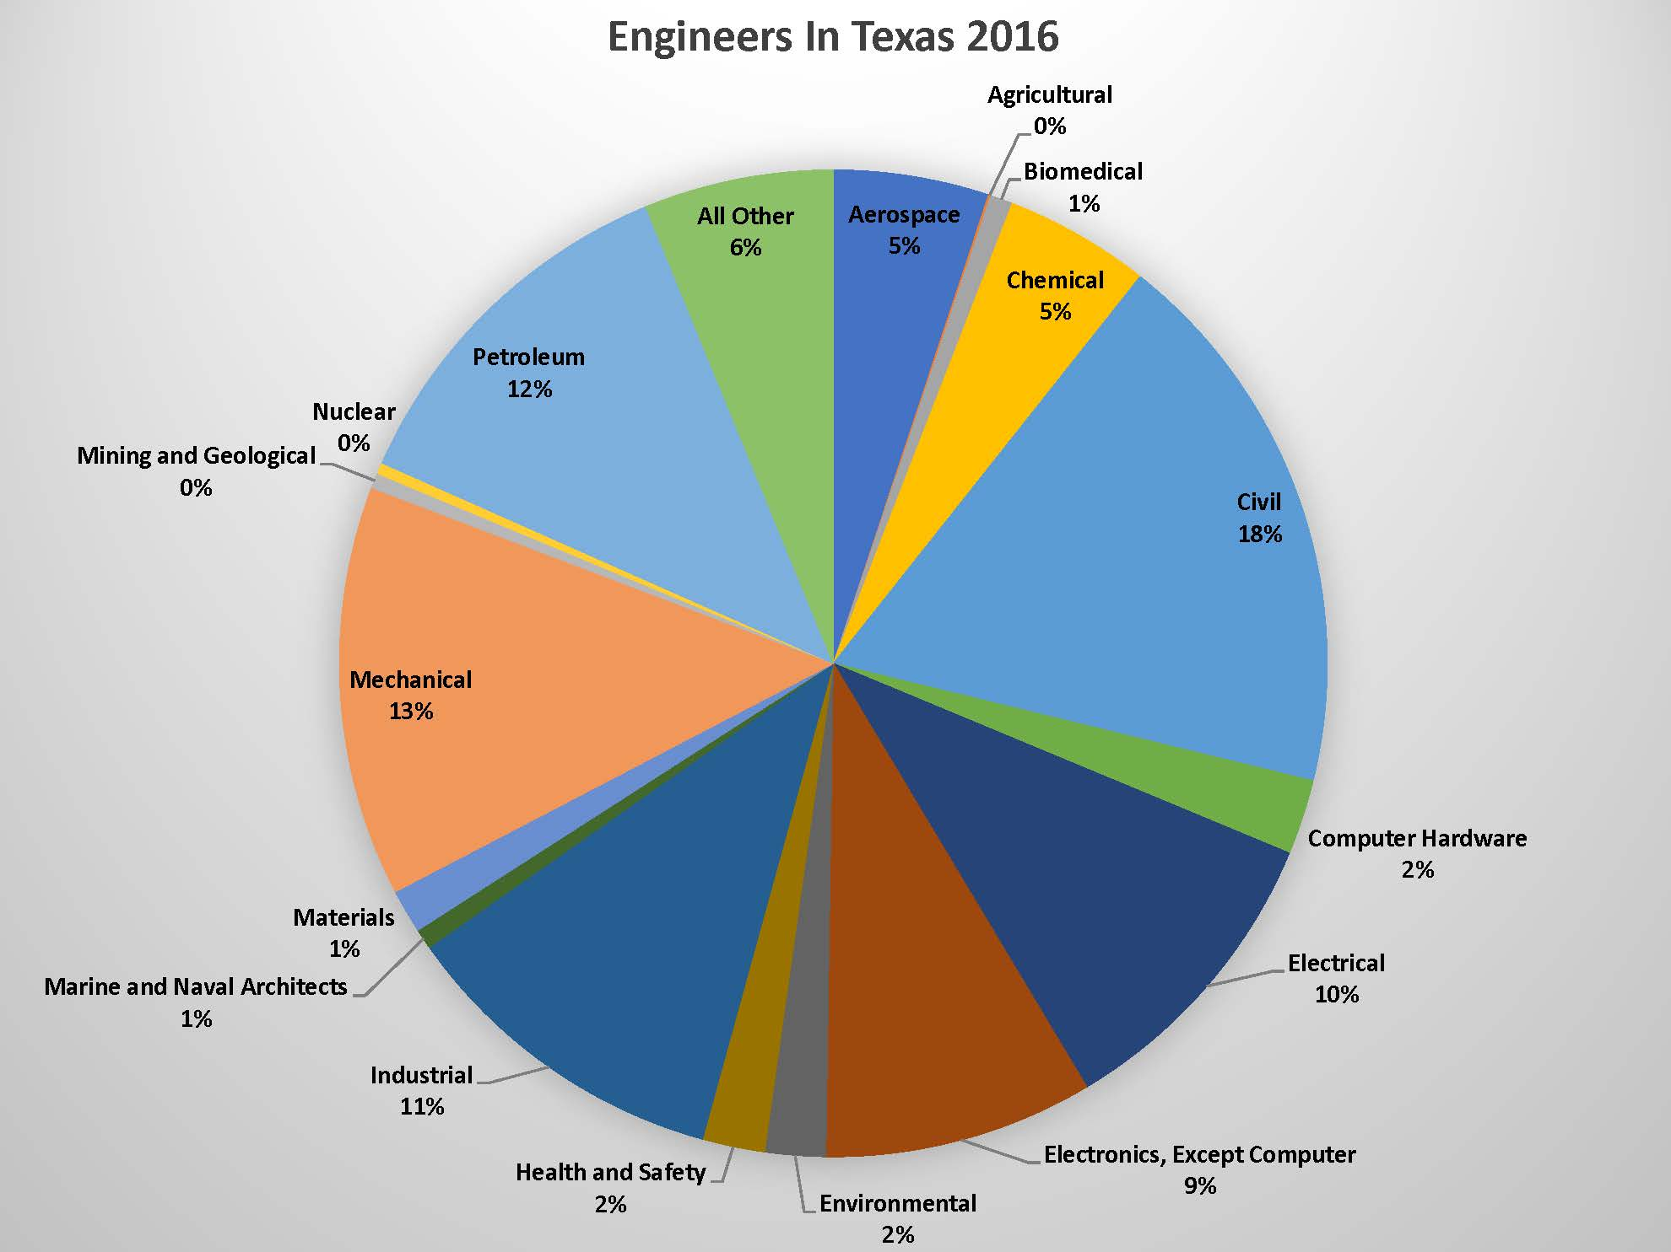
Notes:
Professionals include doctors, lawyers, engineers, etc. There is an understanding that professionals are regulated to ensure ethical behavior which creates a safer environment

Slide 44
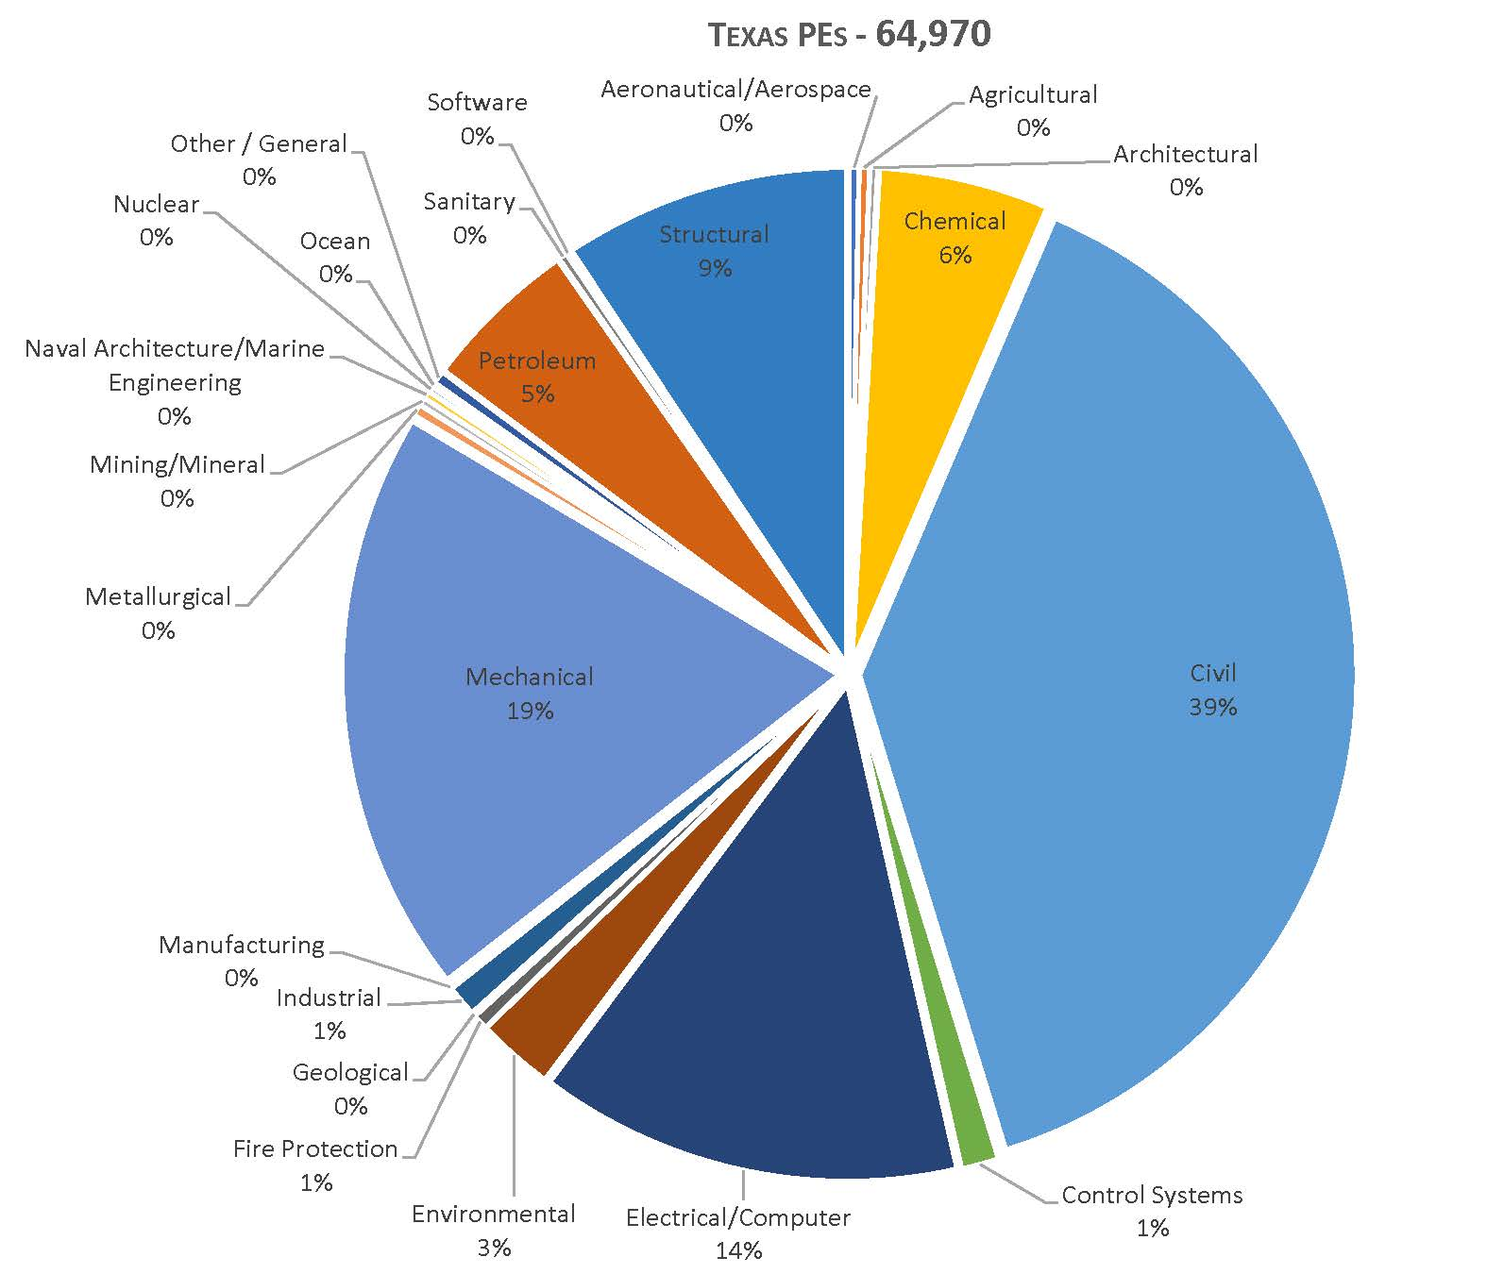
Notes:
Professionals include doctors, lawyers, engineers, etc. There is an understanding that professionals are regulated to ensure ethical behavior which creates a safer environment

Slide 45
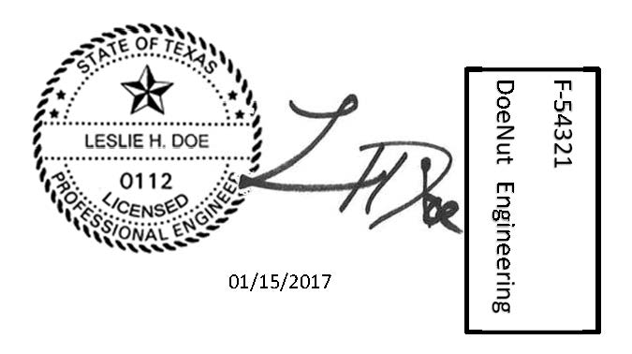
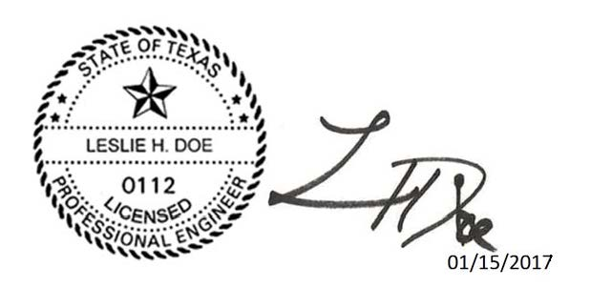
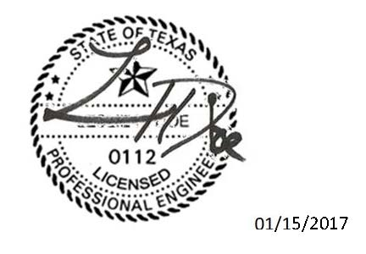
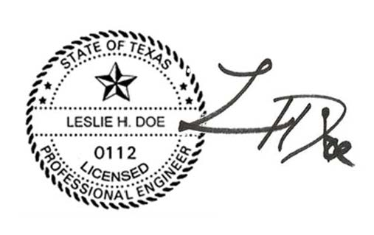
Seals
Which of These is Correct?
A
B
C
D
Notes:
45

Slide 46
Best answers?
A or B
137.33(f) License holders shall affix their seal and original signature or electronic seal and signature with the date on the final version of their engineering work before such work is released from their control.
(1) The signature and date shall not obscure the engineer's name or license number in the seal.
Firm name and number are required on sealed documents, but do not have to be part of the seal itself.
Notes:
Put the job on hold, get your CE updated, renew.
You should maintain current continuing education.
If you get audited – you are required by board rule to respond within 21 days.

Slide 47
Law and Rules
Board is authorized by the Texas Engineering Practice Act
Board interprets and implements the statute to create Rules
Other statutes and rules also apply to engineering (PSPA, Windstorm, Architectural Barriers/ADA, etc.)
Texas Professional Engineers are expected to know the Act, Board Rules, applicable state laws and local codes.
Engineering for a better Texas
Notes:
One reason we are here today is to highlight some of the important rules and laws that each pe should know; however we cannot be exhaustive and it is the responsibility of the PE to know the laws. All of our laws and rules are laid out clearly in a downloadable document on our website which we are happy to mail to you if you need a copy.
Note: Take a copy with you of the most recent statute and rules as reference. Try to allow time after each presentation for one-on-one discussions.
47

Slide 48
Policy Advisory Opinions
Provision Added to TEPA in 2003
Allows Board to develop formal written interpretations of law and rules for specific or hypothetical ‘Gray Areas’
Over 30 interpretations for a variety of subjects
  http://engineers.texas.gov/policy.htm
How to submit PAO Request / Forms at:
  http://engineers.texas.gov/Policy_Advisory.htm

Slide 49
Legislative News
and
Rulemaking
Notes:
Now on to the business of the state. We usually turn up the lights at this point to help keep everyone awake! ;-)
2/23/2018
49

Slide 50
Legislation 85th Session (2017)
Bill filing began November 14, 2016
Session started January 10, 2017
Last filing date March 10, 2017
Regular session adjournment May 29, 2017
TBPE tracks filing and activity
No bills passed related directly to TEPA.
Special Session July 2017
Notes:
The Sunset Advisory Commission reviews agencies every twelve years or so do determine whether it still serves a public need, which would cause the sun to “set” on the agency if not. This is the time when enabling statutes or laws are reviewed and can have changes made. Hearings will be held during the 2013 legislative session. There is an opportunity for public input at that time.

Slide 51
Recent Rules – Hurricane Harvey
September 2017
  Emergency Temporary Licenses for licensed PEs from other states to help with recovery.
  Specific geographical area designated by Governor Abbott (specific counties)
  Limited timeframe (90 days)
  Emergency Board Meeting held September 5, 2017
  Similar rule was enacted after Ike and Katrina
Notes:
The Sunset Advisory Commission reviews agencies every twelve years or so do determine whether it still serves a public need, which would cause the sun to “set” on the agency if not. This is the time when enabling statutes or laws are reviewed and can have changes made. Hearings will be held during the 2013 legislative session. There is an opportunity for public input at that time.

Slide 52
Rules - Decoupling
May 2016
  Allows PE exam to be taken while experience is being obtained. Must be a Texas EIT.
  Increased flexibility for applicants
  Does not reduce licensing requirements.
  October 2016 PE Exam is the first affected
  April 2017 registrations were approximately twice the number from April 2016
Notes:
The Sunset Advisory Commission reviews agencies every twelve years or so do determine whether it still serves a public need, which would cause the sun to “set” on the agency if not. This is the time when enabling statutes or laws are reviewed and can have changes made. Hearings will be held during the 2013 legislative session. There is an opportunity for public input at that time.

Slide 53
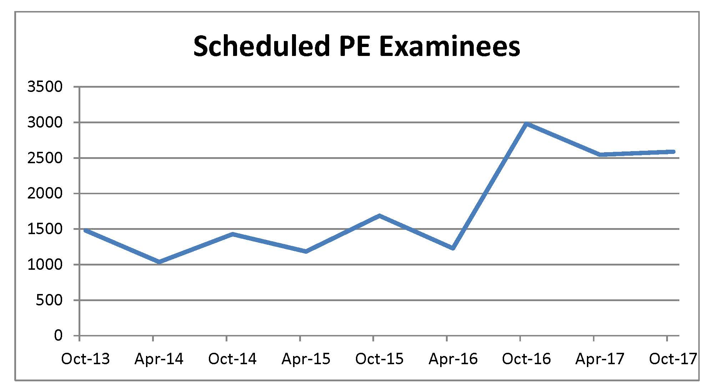
Decoupling
Notes:
The Sunset Advisory Commission reviews agencies every twelve years or so do determine whether it still serves a public need, which would cause the sun to “set” on the agency if not. This is the time when enabling statutes or laws are reviewed and can have changes made. Hearings will be held during the 2013 legislative session. There is an opportunity for public input at that time.

Slide 54
NCEES
  CPC activity tracking system
  CBT – Computer Based Testing
    Fundamentals of Engineering exam 2014
    6 Hour Exam / year-round starting in 2016
    PE exams to be converted over the next five years starting in 2018
      Chemical January 2018 (continuous)
      Nuclear October 2018 (single day)
      Environmental 2019
      Petroleum 2019
      Mechanical, Fire Protection, Industrial – 2020
Notes:
2/23/2018
54
NCEES has begun an initiative for educational requirements to include more than just a bachelor’s degree – a BS plus an extra thirty hours or which is a Masters or Equivalent. Currently, they have not determined what the extra 30 hours will be.
NCEES is about “model law” which may or may not be adopted by other states.

Slide 55
Engagement - Webinars
PE Ethics
  March, June, September, December
  Sign up online
FE Exam / Why become a PE? (Students)
How to Apply (EITs)
Notes:
Professionals include doctors, lawyers, engineers, etc. There is an understanding that professionals are regulated to ensure ethical behavior which creates a safer environment

Slide 56

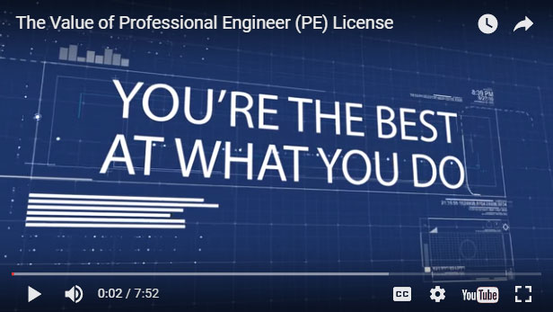
Engagement
Notes:
Professionals include doctors, lawyers, engineers, etc. There is an understanding that professionals are regulated to ensure ethical behavior which creates a safer environment

Slide 57
Outreach
Fiscal Year | Attendees | Presentations
2014 | 14,866 | 155
2015 | 19,751 | 150
2016 | 19,429 | 138
2017 | 23,004 | 150
Quarterly Webinars
Includes K-12 / E-Week
Notes:
2/23/2018
57
If you are interested in having TBPE come to your firm or group, we will speak to groups of 20 or more; look for webinars and hosted meetings in the future.
Outreach to elementary schools is done through the Engineering Week program where we send our staff engineers to local schools to assist with experiments in the classroom. It’s a great way to get involved. If you get a chance to participate we highly recommend it.

Slide 58
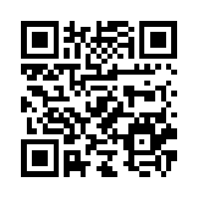
Thank You
1917 S Interstate 35, Austin, TX 78741
Phone: 512-440-3054
Lance.Kinney@engineers.texas.gov
http://engineers.texas.gov/outreachsurvey
Notes:
This year’s theme at TBPE is excellence, and so we are leading with that in our slides.

